Slide 1
Agile SCRUM Basics

Slide 2
Agile Scrum Overview
What is Scrum?
Values
Meetings
Commitment
Courage
Focus
Openness
Respect
Iterative & Incremental
Self-Organized
Roles
Sprint Planning
Daily Scrum
Sprint Review
Sprint Retrospective
Backlog Refinement
Scrum of scrums
Product Owner
Development Team
Scrum Master

Slide 3
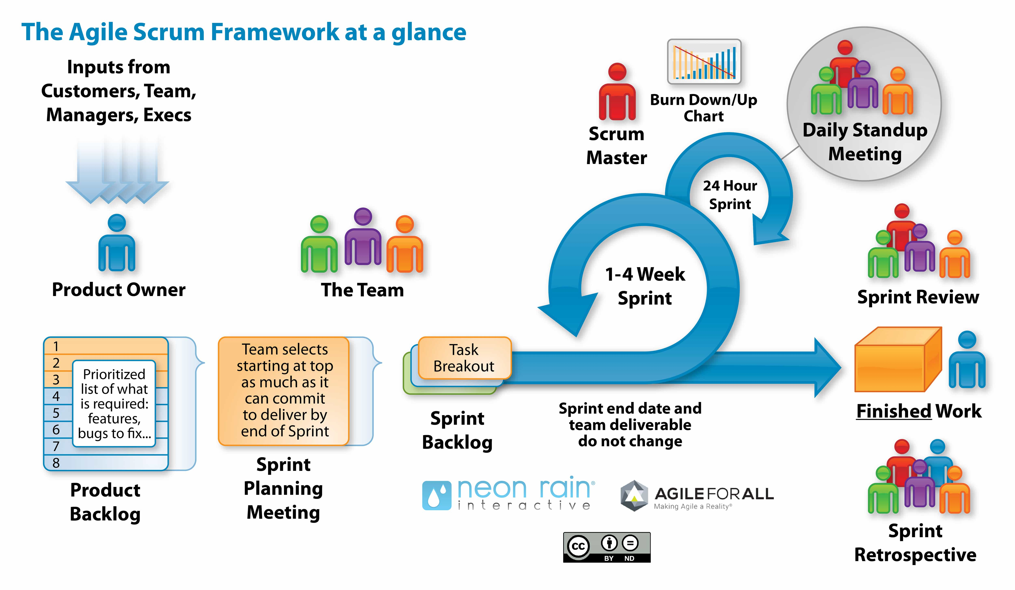

Slide 4
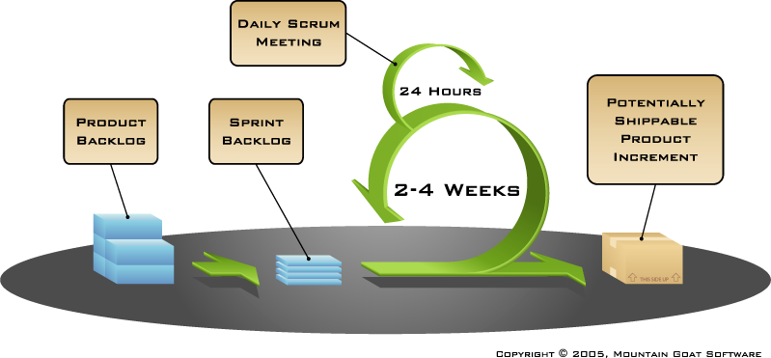
Putting it all together
Image available at www.mountaingoatsoftware.com/scrum

Slide 5
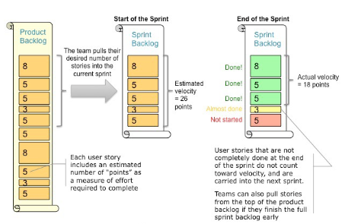
Velocity – is the Key Metric in Scrum

Slide 6
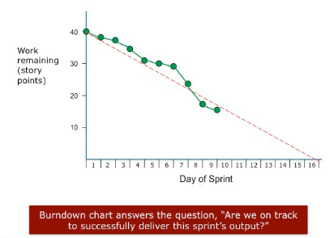
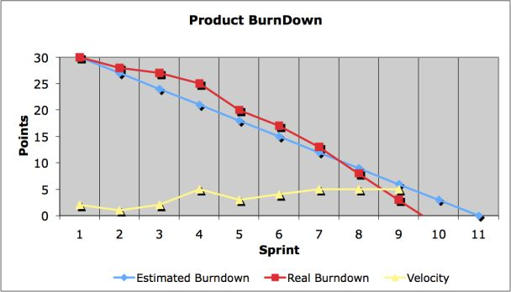
Burndown Chart

Slide 7
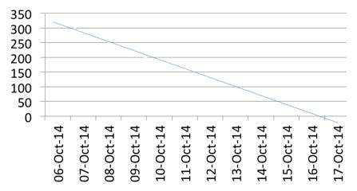
Burndown Chart
For example, let us consider a 2-week sprint -
Sprint Duration: 2 Weeks
No. of Days per Week: 5
No. of Hrs. per Day: 6
No. of Resources: 6
Hence, total remaining effort at the beginning of sprint is 2*5*6*6 = 360 hrs.
Therefore, in an ideal scenario, 36 hours of work gets reduced in the remaining work and the burn-down chart looks as follows -

Slide 8
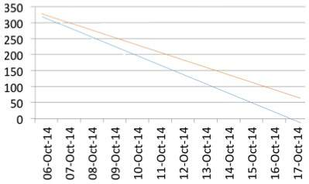
Burndown Chart
If the sprint work is done as planned daily, the scrum progress is almost aligned to the ideal bar.
If the sprint work gets delayed and time commitment is not met, the burn-down chart looks as follows -

Slide 9
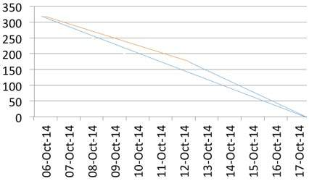
Burndown Chart
But, as the burn-down chart is drawn daily, and the slippage is known early, corrective actions can be taken to meet the sprint time line. Suppose, the team stretches to meet the timeline, the burn-down chart looks as follows –
Thus, at any point in time in a Sprint, the total work remaining in the Sprint can be visualized and possibility of meeting sprint timeline can be improved.

Slide 10
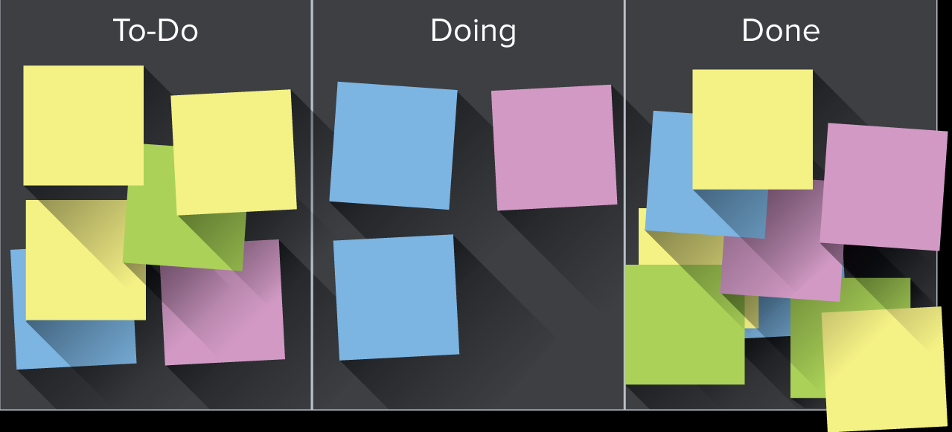
Project management - Kanban
Kanban is a visual signal that's used to trigger an action
Notes:
Kanban is a visual signal that's used to trigger an action. The word kanban is Japanese and roughly translated means “card you can see.” Toyota introduced and refined the use of kanban in a relay system to standardize the flow of parts in their just-in-time (JIT) production lines in the 1950s.

Slide 11

Scrum Framework
Roles
Product owner
ScrumMaster
Team
Ceremonies
Sprint planning
Sprint review
Sprint retrospective
Daily scrum meeting
Artifacts
Product backlog
Sprint backlog
Burndown charts

Slide 12
Scrum Framework
Roles
Product owner
ScrumMaster
Team
Ceremonies
Sprint planning
Sprint review
Sprint retrospective
Daily scrum meeting
Artifacts
Product backlog
Sprint backlog
Burndown charts

Slide 13

Product owner
Define the features of the product
Decide on release date and content
Be responsible for the profitability of the product (ROI)
Prioritize features according to market value
Adjust features and priority every iteration, as needed
Accept or reject work results

Slide 14

The Scrum Master
Represents management to the project
Responsible for enacting Scrum values and practices
Removes impediments
Ensure that the team is fully functional and productive
Enable close cooperation across all roles and functions
Shield the team from external interferences

Slide 15





The Team
Typically 5-9 people
Cross-functional:
Programmers, testers, user experience designers, etc.
Members should be full-time
May be exceptions (e.g., database administrator)

Slide 16
The Team
Teams are self-organizing
Ideally, no titles but rarely a possibility
Membership should change only between sprints

Slide 17
Scrum Framework
Roles
Product owner
ScrumMaster
Team
Ceremonies
Sprint planning
Sprint review
Sprint retrospective
Daily scrum meeting
Artifacts
Product backlog
Sprint backlog
Burndown charts

Slide 18



Team capacity
Sprint planning meeting
Sprint prioritization
Product backlog
Sprint
goal
Analyze and evaluate product backlog
Select sprint goal
Business conditions
Sprint planning
Decide how to achieve sprint goal (design)
Create sprint backlog (tasks) from product backlog items (user stories / features)
Estimate sprint backlog in hours
Current product
Sprint
backlog
Technology

Slide 19
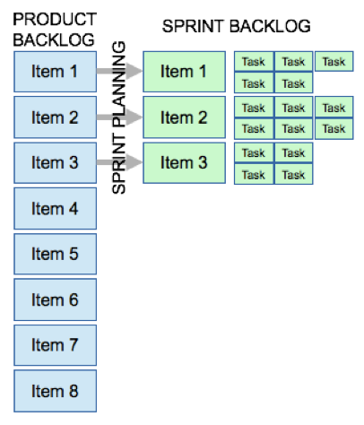
Sprint planning
Team selects items from the product backlog they can commit to completing
Sprint backlog is created
High-level design is considered

Slide 20
The Daily scrum
Parameters
Daily
15-minutes
Stand-up
Only team members, ScrumMaster, product owner, can talk
Helps avoid other unnecessary meetings

Slide 21

Everyone answers 3 questions
1
What did you do yesterday?
2
What will you do today?
3
Is anything in your way?
These are not status for the ScrumMaster
They are commitments in front of peers

Slide 22
The Sprint review
Team presents what it accomplished during the sprint
Typically takes the form of a demo of new features or underlying architecture
Informal
Normally held for two hours for two week sprints and for four hours for one month sprints.
No slides
Whole team participates
Invite the world

Slide 23
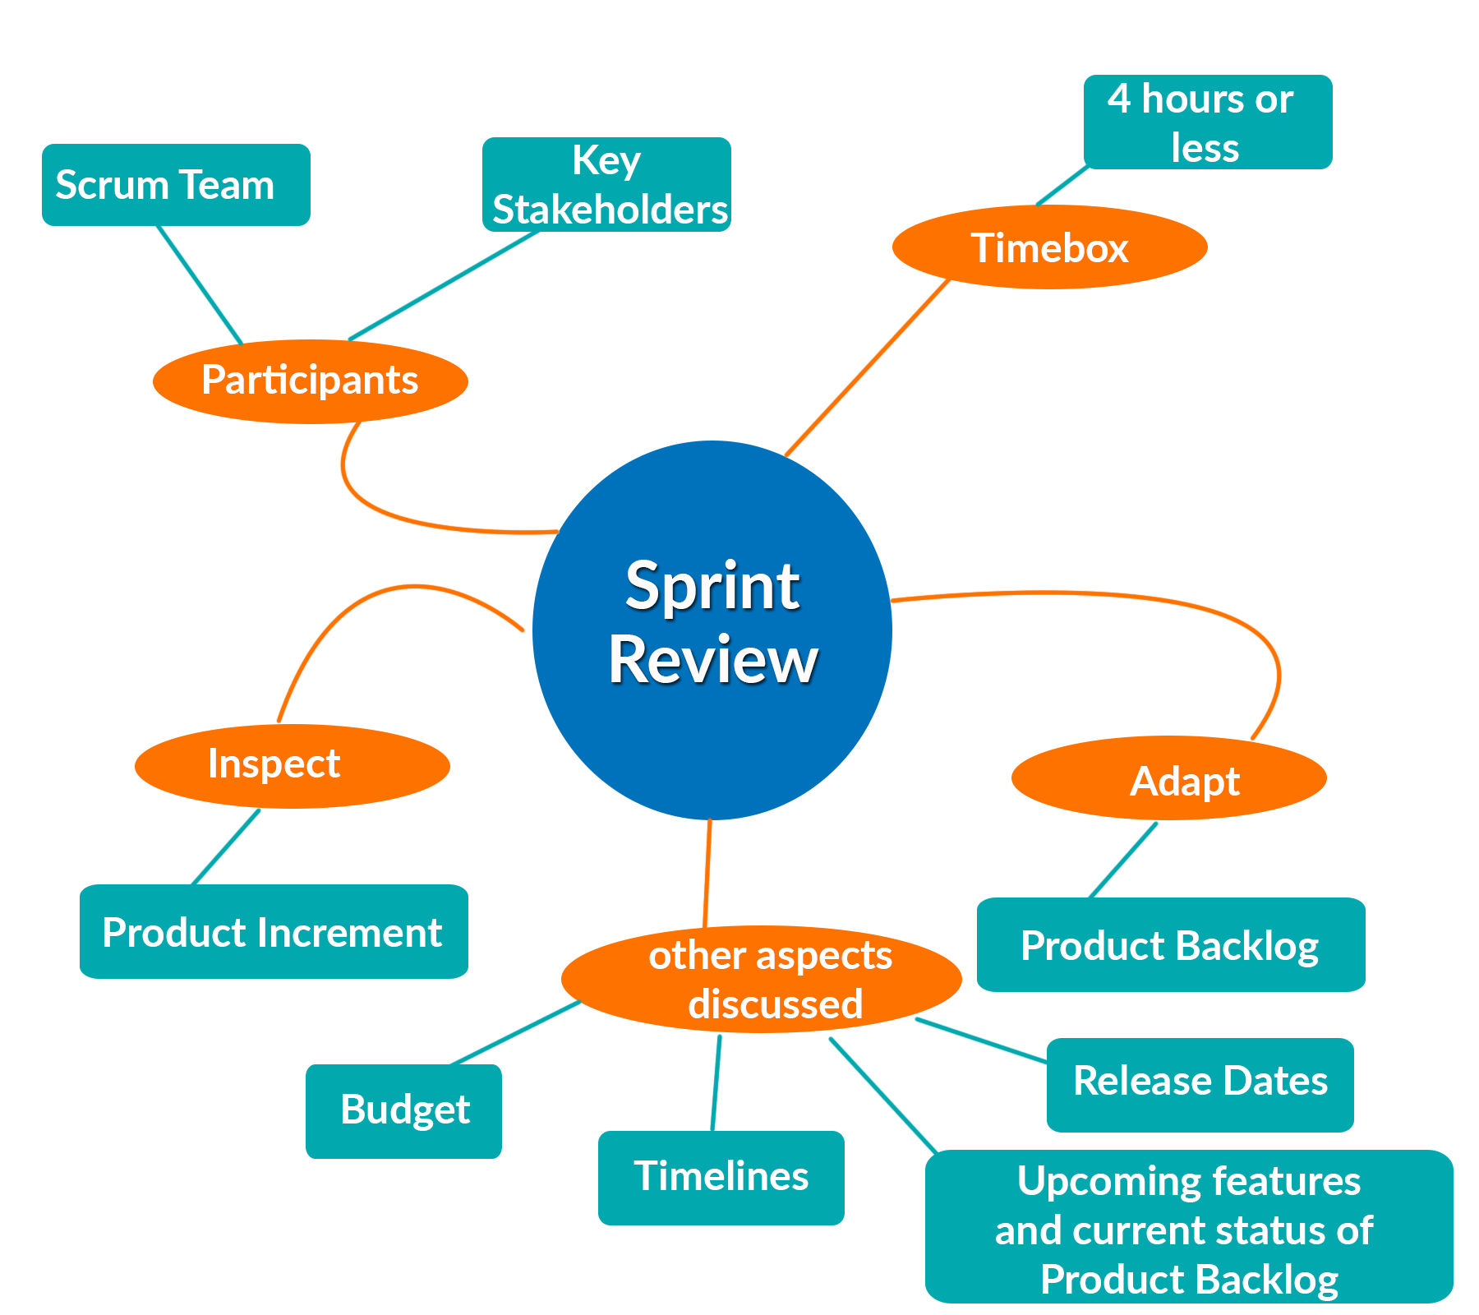
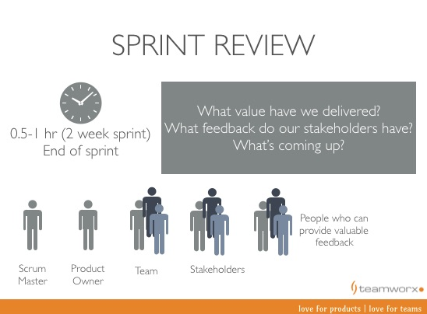
The Sprint review

Slide 24
Sprint Retrospective
Occurs after the Sprint Review and prior to the next Sprint Planning.
Usually a one hour meeting for two-week duration sprints and a three hour meeting for one month duration Sprints.
Opportunity for the Scrum Team to introspect and improve within the Scrum process framework so as to make the next Sprint outcome more effective.

Slide 25
Sprint Retrospective
The purpose of the Sprint Retrospective is to -
Combine the learnings from the last Sprint, with regards to people, relationships etc.
Identify the major items that went well and potential improvements.
Creation of a plan for implementing improvements to increase product quality.
Whole team participates

Slide 26

Start / Stop / Continue
Whole team gathers and discusses what they’d like to:
Start doing
Stop doing
This is just one of many ways to do a sprint retrospective.
Continue doing

Slide 27
Scrum framework
Roles
Product owner
ScrumMaster
Team
Ceremonies
Sprint planning
Sprint review
Sprint retrospective
Daily scrum meeting
Artifacts
Product backlog
Sprint backlog
Burndown charts

Slide 28

Product backlog
The requirements
A list of all desired work on the project
Ideally expressed such that each item has value to the users or customers of the product
Prioritized by the product owner
Reprioritized at the start of each sprint
This is the product backlog

Slide 29
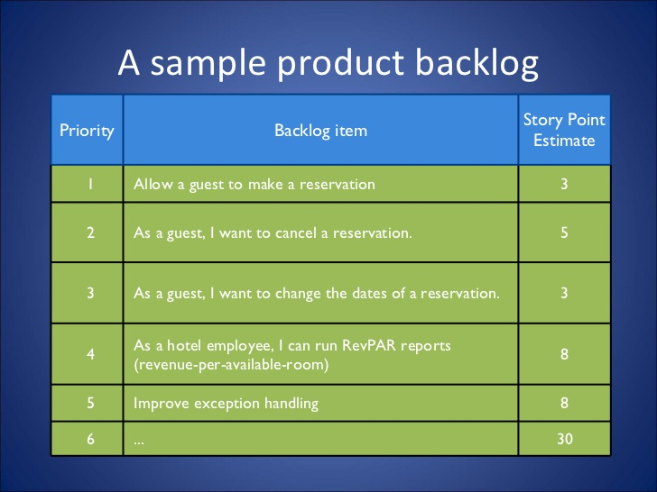
A Sample product backlog

Slide 30
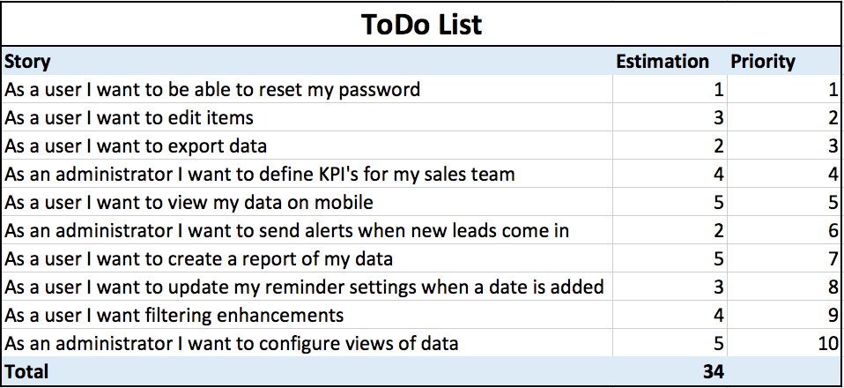
A Sample product backlog

Slide 31
Sprint backlog
The sprint backlog is a list of tasks identified by the Scrum team to be completed during the Scrum sprint.
During the sprint planning meeting, the team selects some number of product backlog items, usually in the form of user stories, and identifies the tasks necessary to complete each user story.
It's critical that the team selects the items and size of the sprint backlog. Because they are the people committing to completing the tasks, they must be the people to choose what they are committing to during the Scrum sprint.
The sprint backlog is commonly maintained as a spreadsheet, but it is also possible to use your defect tracking system or any of a number of software products designed specifically for Scrum or agile.
Any team member can add, delete or change the sprint backlog
If work is unclear, define a sprint backlog item with a larger amount of time and break it down later

Slide 32
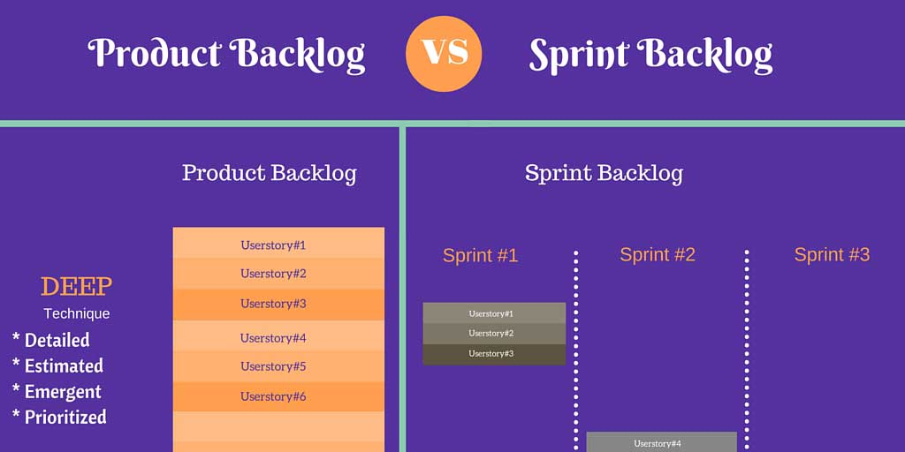
Sprint backlog

Slide 33
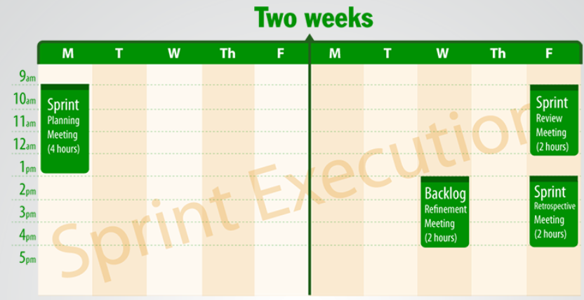
SCRUM Meetings (2 weeks Sprint)
Sprint Planning Meeting- 4 – 8 Hours
Daily Scrum Meeting – 15 Minutes
What I did yesterday?
What I will today?
Impediment
Sprint Review Meeting – 1 – 2 Hours. Live demo
Sprint Retrospective Meeting – 2 Hours
Find the cause , not people

